Slide 1
Lesson 2: Data Types in JavaScript

Slide 2
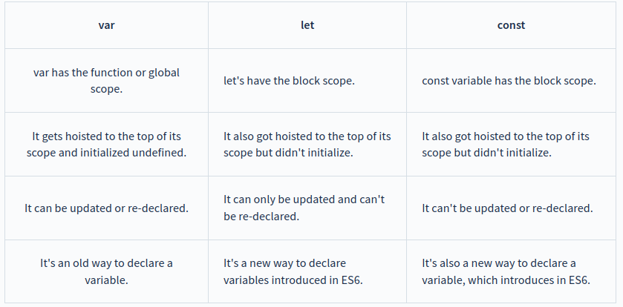
Variable Declaration: var, let and const

Slide 3
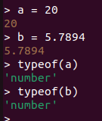
Number
Declaring Integer type variable in JavaScript :-
var x = 23;
let x = 20;

Slide 4
JavaScript has a single number type. Internally, it is represented as 64-bit floating point, the same as Java’s double. Unlike most other programming languages, there is no separate integer type, so 1 and 1.0 are the same value. This is a significant convenience because problems of overflow in short integers are completely avoided, and all you need to know about a number is that it is a number. A large class of numeric type errors is avoided.
Ref: Douglas Crockford - JavaScript_The Good Parts (2008)

Slide 5
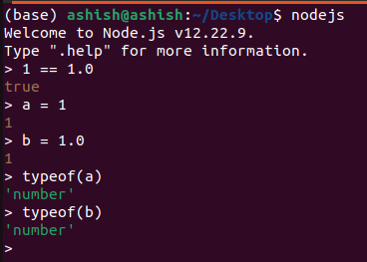
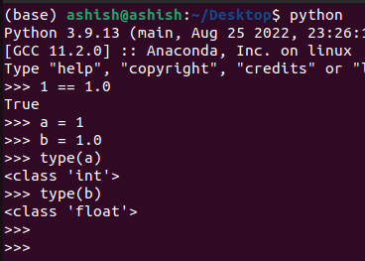
Number

Slide 6
Strings
Declaring String variable in JavaScript :-
// Using string template
var variable = “Gokul Krishna”
// Using String class
var variable = new String(“Gokul Krishna”);

Slide 7
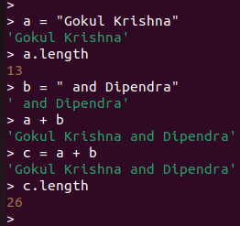
String Concatenation: Part 1

Slide 8
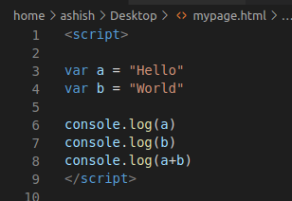

String Concatenation: Part 2

Slide 9
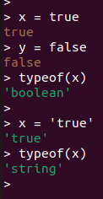

Boolean in JavaScript
let x = true;
let y = false;
let result = x.toString();
console.log(result);
In Python:

Slide 10
Arrays
var arr_num = [1, 2, 3, 0, -5, -2]
let arr_names = ['Dip', 'Gokul', 'Krishna', 'Ashish']
let arr_of_mixed_types = [1, 'Krishna', true]
To name a few operations that we can do on an array:
(1) Traversing or 'Iterating over the elements of an array'
(2) Sort
(3) Search
(4) Insertion
(5) Deletion
(6) Reversing

Slide 11
Hello, Arrays in Code!
var arr_num = [1, 2, 3, 0, -5, -2]
console.log(arr_num)
console.log(arr_num.sort()) // Changes the actual object. Return type: modified array.
console.log(arr_num.reverse()) // Changes the actual object.
// These operations sort() and reverse() change the actual object.
// The push() method adds new items to the end of an array.
arr_num.push(10)
console.log(arr_num)

Slide 12
Date
Using new Date()
new Date() without arguments, creates a date object with the current date and time:
const d = new Date();
Fri Aug 18 2023 16:49:21 GMT+0530 (India Standard Time)

Slide 13
Thank you!

